Slide 1
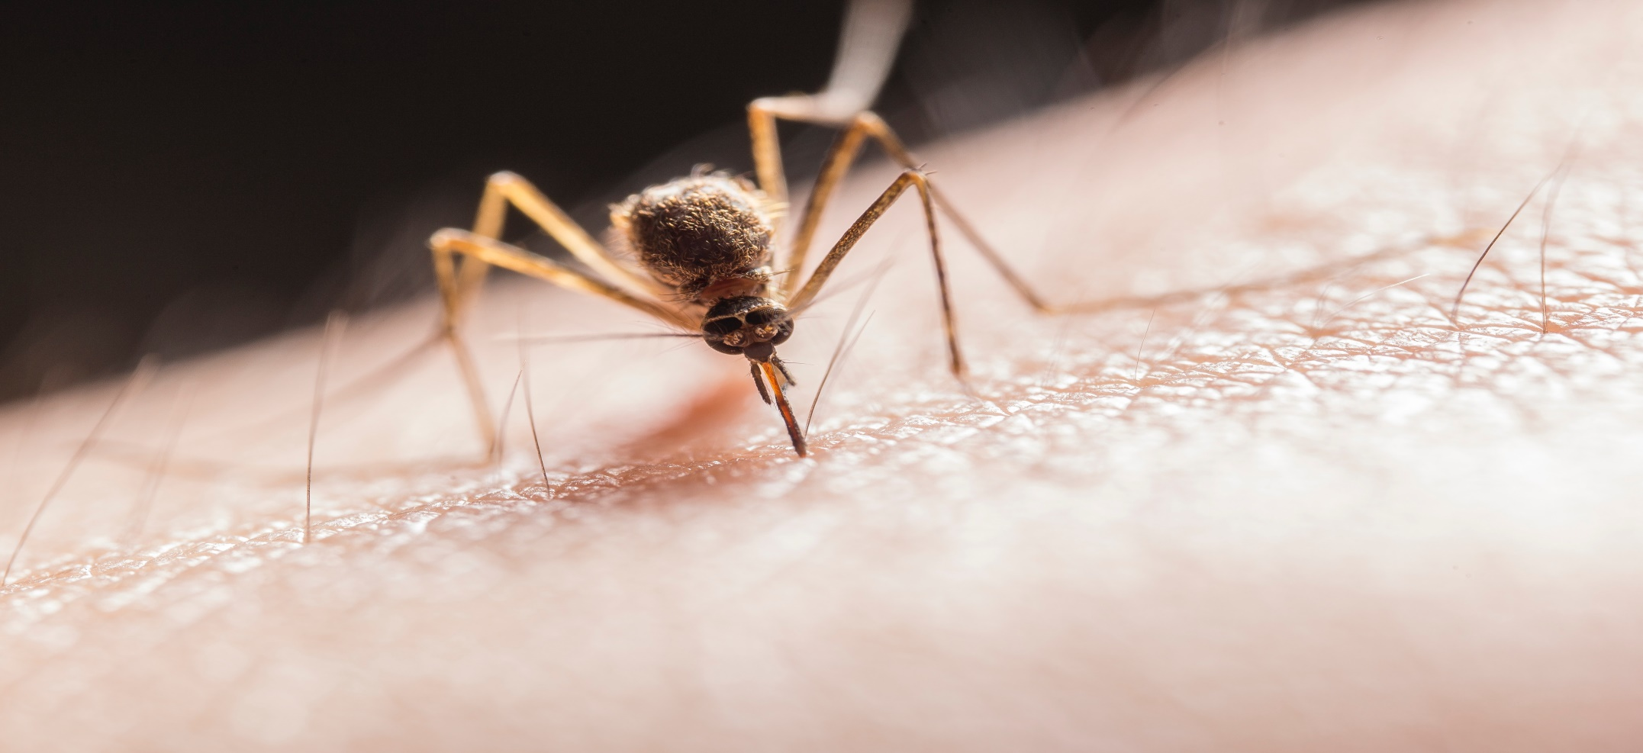
MALARIA

Slide 2
What is malaria?
A disease transmitted by mosquitoes
It is caused by a single celled parasite called Plasmodium.

Slide 3
What are the symptoms?
Chills
Fever
Exhausting sweats
Headache
Muscle aches
Tiredness

Slide 4
Particularly at risk are:
Infants
Children under 5
Pregnant women
Those who are HIV positive

Slide 5
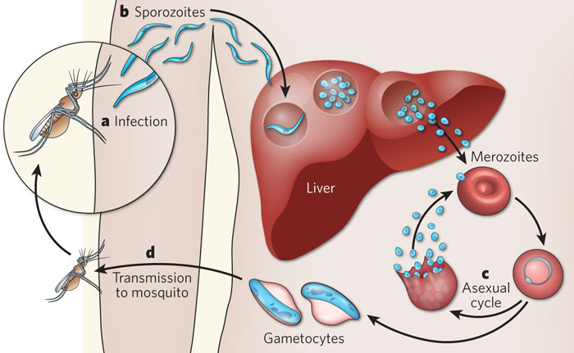
Life Cycle of Plasmodium

Slide 6
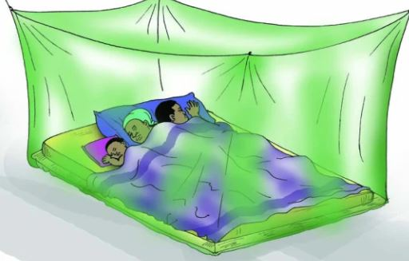
PRIMARY PREVENTION
sleeping under a mosquito net reduces cases of malaria by 50%

Slide 7
Citation
CDC. (n.d.). CDC - Malaria - About Malaria - FAQs. Cdc.Gov. https://www.cdc.gov/malaria/about/faqs.html
NHS website. (2018, August 24). Prevention. Nhs.Uk. https://www.nhs.uk/conditions/malaria/prevention/#:%7E:text=Malaria%20can%20often%20be%20avoided,and%20using%20a%20mosquito%20net.
Schafer, J. (2013, September 16). 1001 Bites: The road to a successful malaria vaccine. Science in the News. https://sitn.hms.harvard.edu/flash/2013/1001-bites-the-road-to-a-successful-malaria-vaccine/

